Slide 1


DESIGN 1
Lesson 2: Guided Practice: Building Lists
Ms. Abboud • Grade 9 - Design 1 • Term 1, Week 4

Slide 2
Learning Objectives
WALT - We Are Learning To
WILF - What I'm Looking For
Build correctly nested ordered and unordered lists, with support.
Spot and fix common list syntax errors.
Both list types render correctly with no errors.
My nested list (if attempted) is structured correctly.

Slide 3
Academic Vocabulary
Nested List
A list placed inside a list item of another list - used to show sub-groups within a bigger category.

Slide 4
Frayer Model: Nested List
DEFINITION
CHARACTERISTICS
A list placed inside a list item of another list, used to show sub-groups within a bigger category.
The inner <ul>/<ol> sits inside an <li> of the outer list; inner tags close before the outer <li> closes.
NESTED LIST
EXAMPLES
NON-EXAMPLES
<ul>
<li>Web Design
<ul><li>HTML</li></ul>
</li>
</ul>
Two separate <ul> lists placed one after another - not nested, just two lists.

Slide 5
National Identity Integration
UAE Heritage and Culture: organizing cultural information clearly - like types of Emirati dishes grouped by category - often calls for nested lists, with main categories and sub-items underneath.

Slide 6
STARTER
Fix It: Spot the Error
A list is missing a closing </li> tag - can you spot where?
Turn and talk: what would happen if we left it broken?
Hook • Engage & Ask
5 - 10 minutes

Slide 7
LESSON CORE
I Do: Teacher Demo
Watch: build an unordered list, then convert it to ordered - see how little changes.
Then: nest a list inside a list item, for sub-groups.
Gradual Release of Responsibility
30 - 40 minutes
Example: a nested list
<ul>
<li>Web Design
<ul>
<li>HTML</li>
<li>CSS (coming later)</li>
</ul>
</li>
<li>Programming</li>
</ul>
1 / 3

Slide 8
LESSON CORE
We Do: Build Together, Checkpoint by Checkpoint
Checkpoint 1: build an unordered list with 3+ items.
Checkpoint 2: build an ordered list with 3+ items.
Common error check: unclosed <li> tags, items placed outside the <ul>/<ol>.
Gradual Release of Responsibility
30 - 40 minutes
2 / 3

Slide 9
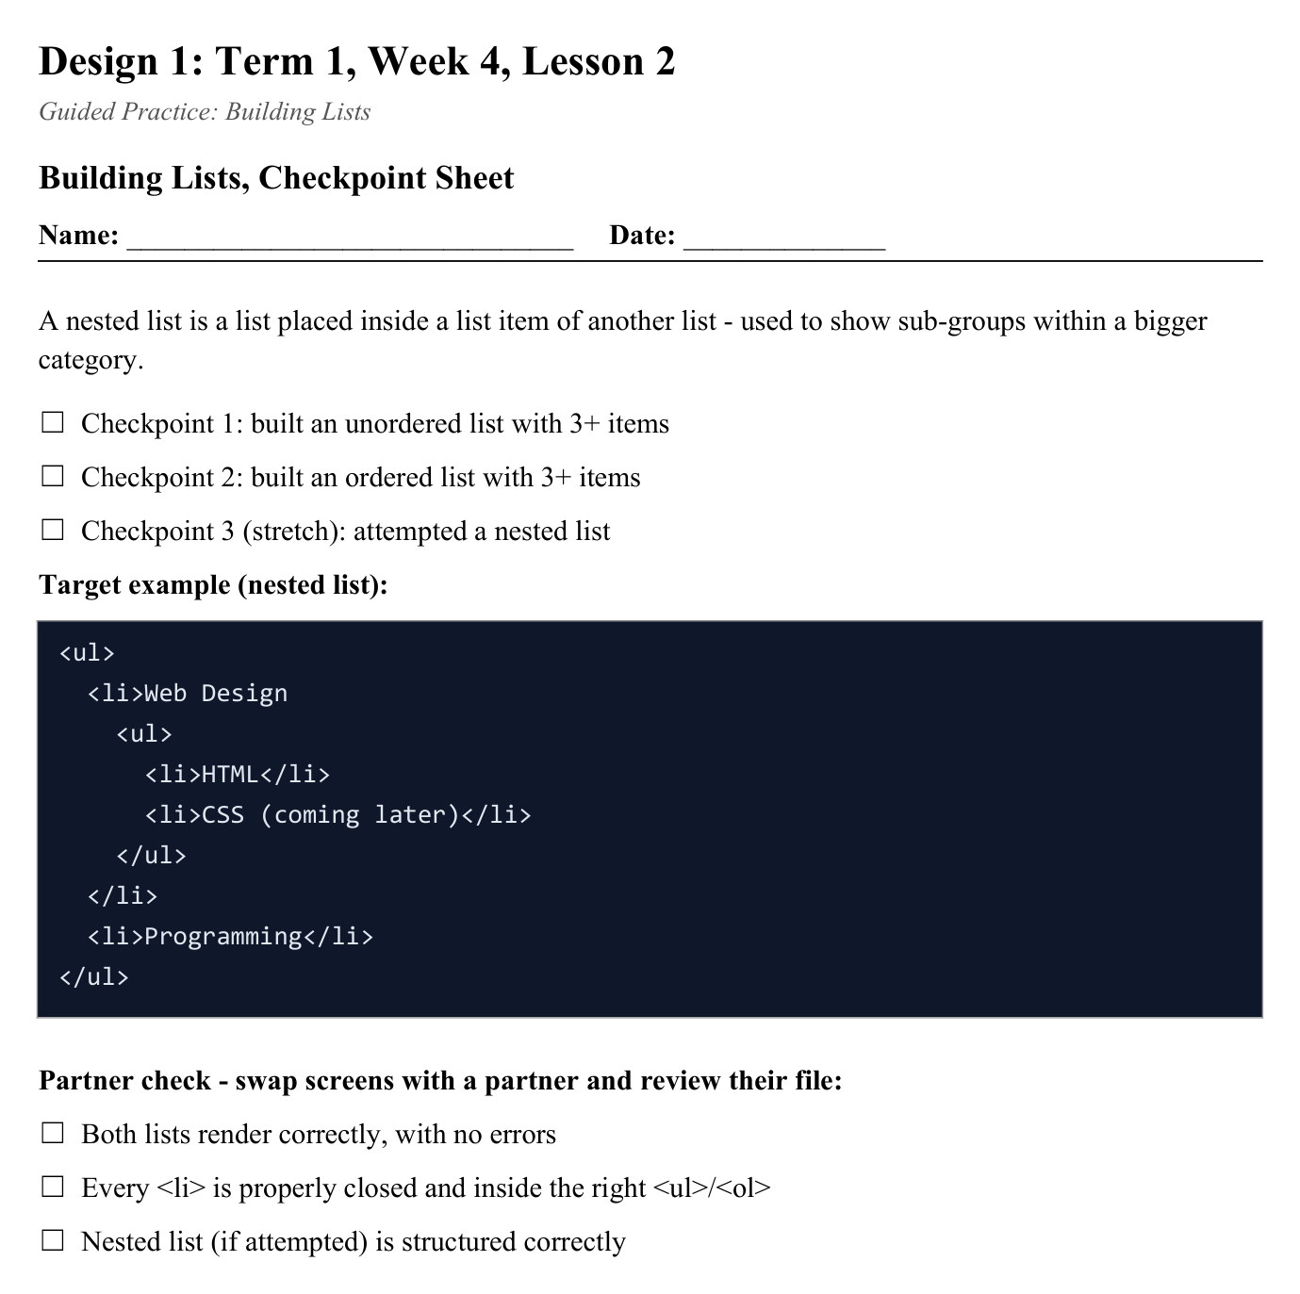
LESSON CORE
You Do: Build & Nest
Build both list types on your site, then attempt one nested list - use the Checkpoint Sheet to track your progress.
Activity: Building Lists, Checkpoint Sheet
Gradual Release of Responsibility
30 - 40 minutes
3 / 3

Slide 10
CLOSURE
Quick Check
Submit a screenshot of your rendered lists for a quick teacher check.
Transition & Extend
5 - 10 minutes

